Slide 1
Hello!
I’m Nidhi Mathur
Front End Web Developer
&
Graphic-Web Designer

Slide 2


LetsGrowMore (LGM)
Virtual
Internship
Program (VIP)

Slide 3


Slide 4
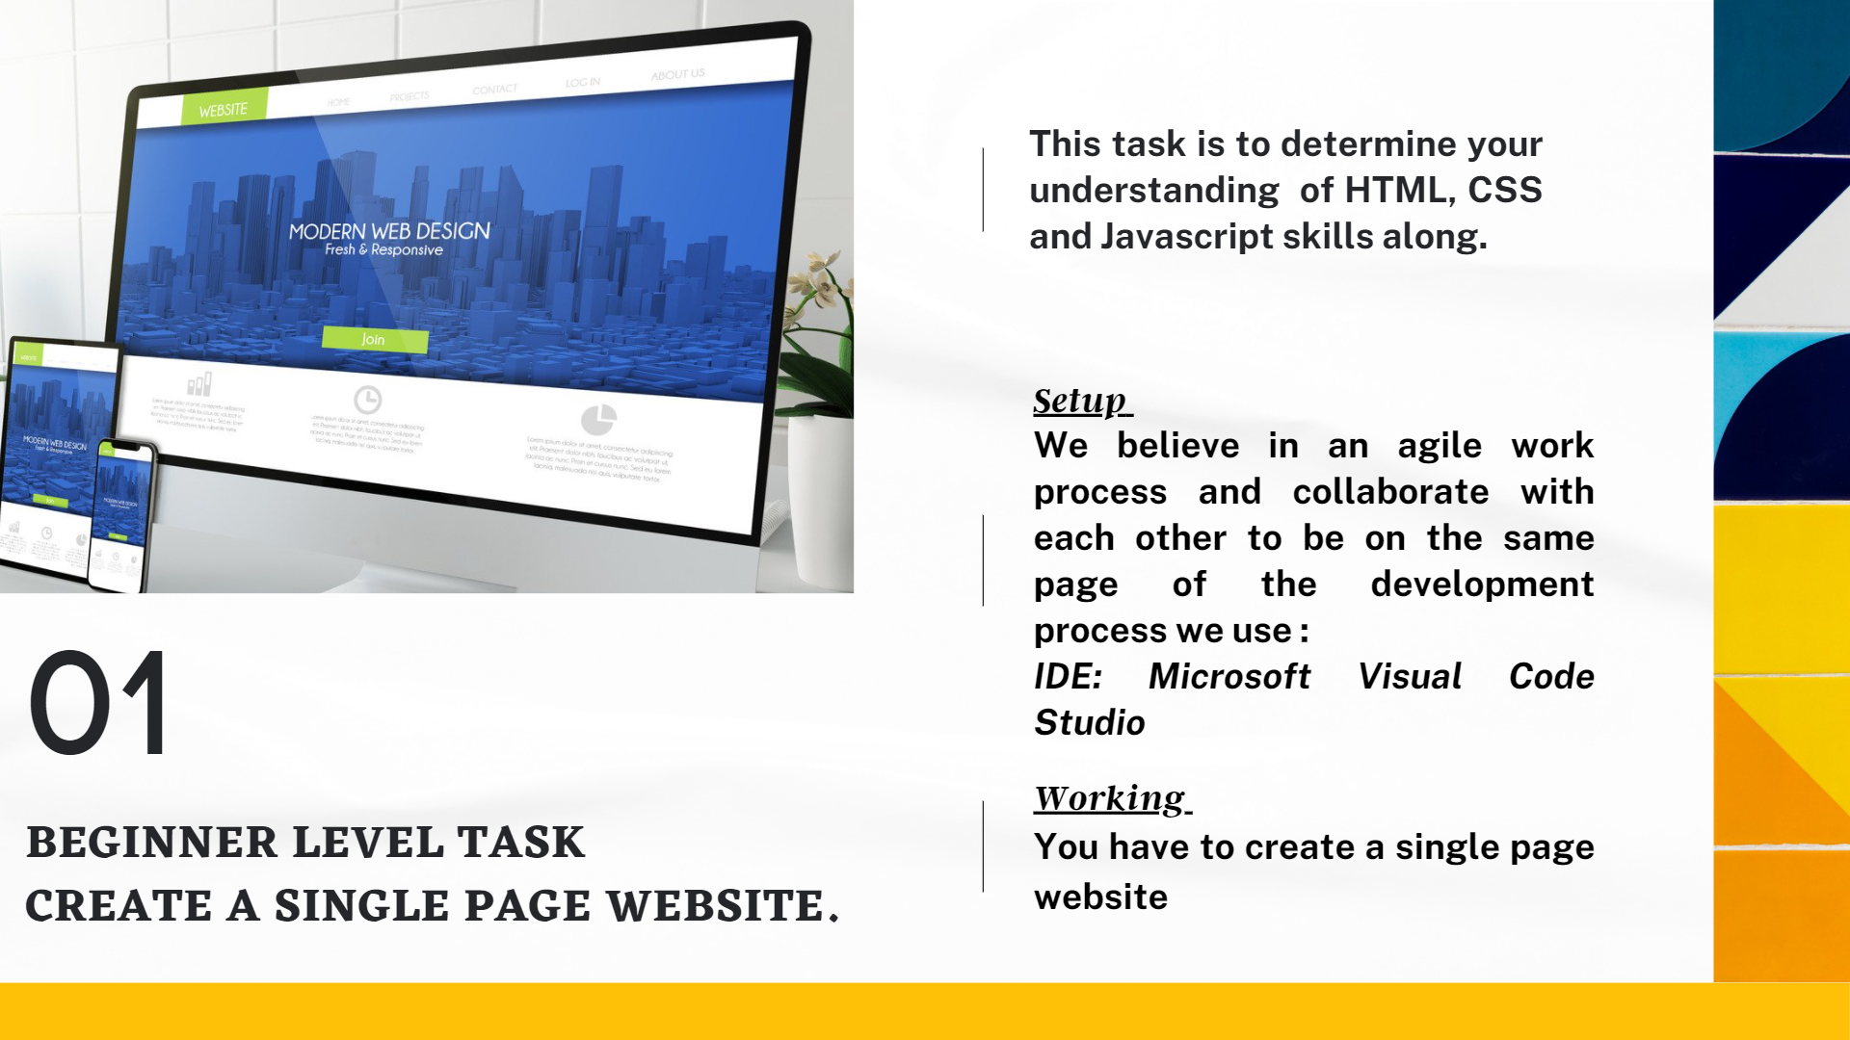

Slide 5
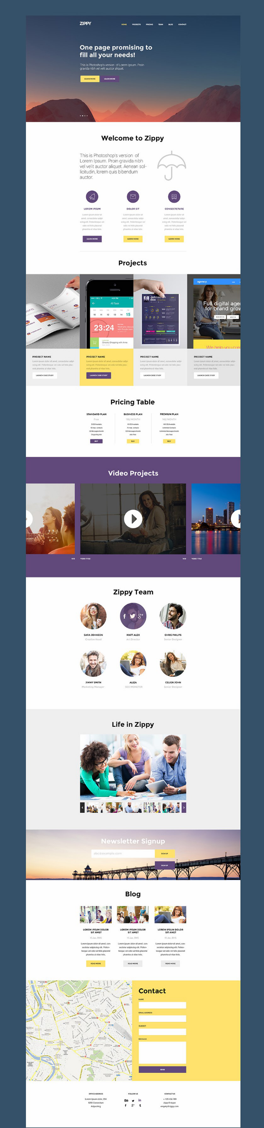

Slide 6
Thank you!
Hope you all liked my project…

